Slide 1
Introduction to WEB DEVELOPMENT
Amr Mohamed Eissa

Slide 2
AGENDA
Introduction about Web Development
What do you need
How websites works
Static & Dynamic Web Pages

Slide 3
Introduction
What is Web applications refers to ?
Web applications refers to all types of applications that hosted within a web browser.
What is Intranet?
is a private network that uses web technology and that can be accessed only by authorized persons.

Slide 4
Introduction
What do you need to make website ?
1- Your PC 💻
2- Text Editor (Visual Code , Brackets , Atom ….. )
3- Web Browser (Google Chrome , Microsoft Edge , Firefox , Yandex)
4- your mind 🧠😉

Slide 5
Introduction
How Does the Web Work ?
The browser (or client) requests and displays information.
Browsers make requests of servers.
On the server a web server software processes the On the server, a web server software processes the requests and returns information to the client.

Slide 6
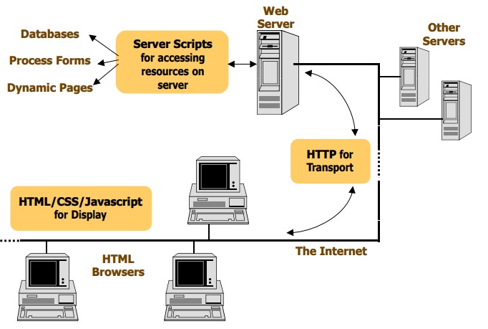

Slide 7
Introduction
Website Structure ?
1- HTML Files
2- Image Files (optional)
ex:- GIF , JPG , JPEG , PNG ….
3- Object Files (optional)
ex:- Videos , Sounds
4- Server-Side Scripts (optional)
ex:- ASP.NET
Notes:
1- These HTML files may also include client-side scripting (usually Javascript).
2- (GIF and JPG) that are supported by all browsers.
3- Object files :- Files that require a helper application or plug-in.
4- server-side:- programs for accessing server-based resources such as databases.

Slide 8
Introduction
What is the Basic Web Development Process ?
1- Create HTML Files.
2- Test Locally on Browser.
3- Upload Files (html files , images , other scripts) to web server.
4- Test Page on Web Server.

Slide 9
Introduction
Static vs Dynamic Web Pages ?
Static Pages :-
Most web pages are not static , static means that the web page present only the contents & tags of the page only

Slide 10
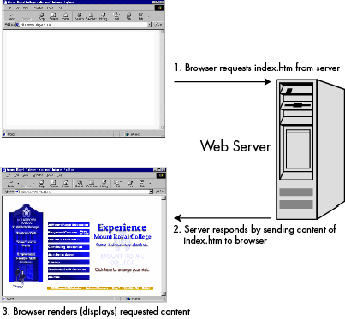
Introduction
Static vs Dynamic Web Pages ?
Static Pages :-
Most web pages are not static , static means that the web page present only the contents & tags of the page only .

Slide 11
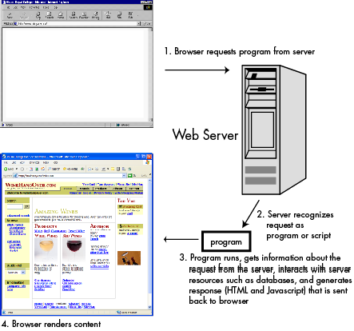
Introduction
Static vs Dynamic Web Pages ?
Dynamic Pages :-
Look like e-commerce website , return data from server resources like (Database) and present it into the page.
----------------------------------------
technologies for dynamically generating Web content (PHP , ASP.NET , NODE.JS)

Slide 12
Thank You
Amr Mohamed Eissa

